Slide 1

Spring Framework

Slide 2
Ioc - Inversion of Control
IoC
At its core, IoC, and therefore DI, aims to offer a simpler mechanism for provisioning component
dependencies (often referred to as an object’s collaborators) and managing these dependencies throughout their life cycles.
A component that requires certain dependencies is often referred to as the dependent object
or, in the case of IoC, the target.
In general, IoC can be decomposed into two subtypes:
dependency injection
dependency lookup

Slide 3
IOC
With dependency lookup–style IoC, a component must acquire a reference to a dependency, whereas with dependency injection, the dependencies are injected into the component by the IoC container.
Dependency lookup comes in two types:
Dependency pull
Contextualized dependency lookup (CDL).
Dependency injection also has two common flavors:
constructor and setter dependency injection.

Slide 4
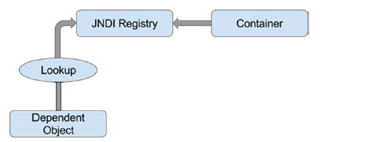
IOC
Dependency Pull
In dependency pull, dependencies are pulled from a registry as required.

Slide 5
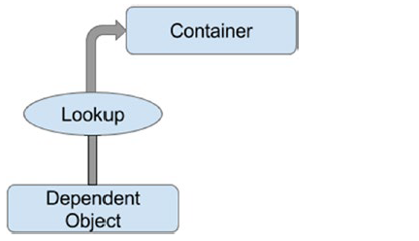
IOC
Contextualized Dependency Lookup
Contextualized dependency lookup (CDL) is similar, in some respects, to dependency pull, but in CDL,lookup is performed against the container that is managing the resource, not from some central registry.

Slide 6
IOC
Constructor Dependency Injection
Constructor dependency injection occurs when a component’s dependencies are provided to it in its constructor (or constructors). The component declares a constructor or a set of constructors, taking as arguments its dependencies, and the IoC container passes the dependencies to the component when instantiation occurs.
Setter Dependency Injection
In setter dependency injection, the IoC container injects a component’s dependencies via JavaBean-style setter methods. A component’s setters expose the dependencies the IoC container can manage.

Slide 7
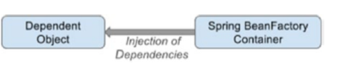
IOC in spring
Spring supports both constructor and setter injection and bolsters the standard IoC feature set with a whole host of useful additions to make your life easier.

Slide 8
IOC in spring
Beans and BeanFactory
The core of Spring’s dependency injection container is the BeanFactory interface. BeanFactory is responsible for managing components, including their dependencies as well as their life cycles. In Spring, the term bean is used to refer to any component managed by the container.

Slide 9
Bean Scopes
Singleton: The default singleton scope. Only one object will be created per Spring IoC
container.
• Prototype: A new instance will be created by Spring when requested by the
application.
• Request: For web application use. When using Spring MVC for web applications,
beans with request scope will be instantiated for every HTTP request and then
destroyed when the request is completed.
• Session: For web application use. When using Spring MVC for web applications,
beans with session scope will be instantiated for every HTTP session and then
destroyed when the session is over.

Slide 10
Bean Scopes
Global session: For portlet-based web applications. The global session scope beans can
be shared among all portlets within the same Spring MVC–powered portal application.
Thread: A new bean instance will be created by Spring when requested by a new
thread, while for the same thread, the same bean instance will be returned. Note that
this scope is not registered by default.
• Custom: Custom bean scope that can be created by implementing the interface
org.springframework.beans.factory.config.Scope and registering the custom
scope in Spring’s configuration (for XML, use the class org.springframework.
beans.factory.config.CustomScopeConfigurer).

